Slide 1
Sensor Synergy of Lidar and Vision-Based Detection for Obstacle Mapping in Simulated Environments
- Gaurav Surtani

Slide 2
Abstract
Proposal for augmenting Lidar with an additional sensor to enhance autonomous vehicle safety and decision-making through sensor fusion. Aims to evaluate the effectiveness of multi-sensor integration in improving obstacle detection in simulated environments.

Slide 3
Introduction
Background on reliance of self-driving cars on Lidar. Problem statement addressing the accuracy issues with single-sensor systems. Objectives include measuring Lidar accuracy, integrating additional sensors, and creating a simulation to demonstrate improved detection capabilities.

Slide 4
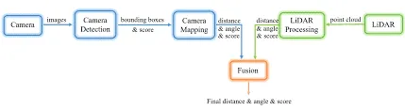
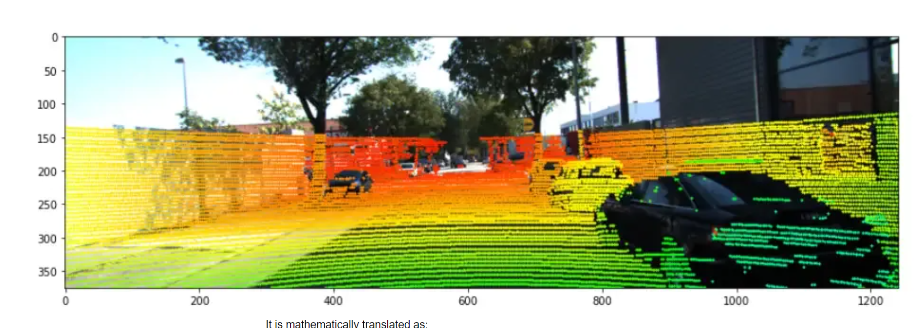
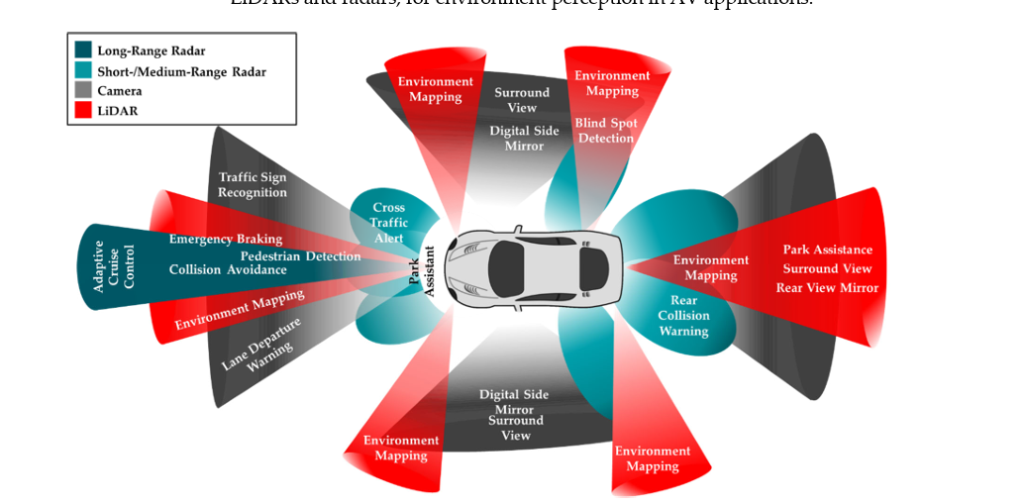
Methodology
Selection of Lidar for its accuracy, paired with Radar, Camera, Ultrasonic, Infrared, and Inertial measurement sensors(IMU), GPS, sensors. Use of Python libraries for simulation and visualization, and exploration of early-fusion, deep-fusion, and late-fusion techniques.

Slide 5
Implementation Plan
First, we need to find the coordinates of one 2D point on the image and the coordinates of the 3D point from the points cloud generated by the LiDAR scanner.
To apply sensor fusion techniques, what we need to do is to select the points that are visible in the image, convert them from the LiDAR frame to the Camera Frame, and finally find a way to project the points from the Camera Frame to the Image Frame.
Timeline includes project setup, simulation environment construction, sensor data fusion development, testing, refinement, analysis, and documentation. Risk management strategies for potential incompatibilities, limited testing time, and software issues.

Slide 6
Expected Results
Anticipation of increased accuracy in object detection and decision-making process improvements for autonomous vehicles. Evaluation of object detection speed and coverage.

Slide 7
Conclusion
The goal is to utilize sensor fusion to enhance Lidar's accuracy for better object and threat detection, and to identify the most effective sensor fusion algorithms.

Slide 8
References
1. "Sensor Fusion Module Using IMU and GPS Sensors For Autonomous Car," in Proceedings of the 2020 IEEE International Conference for Innovation in Technology (INOCON), Bengaluru, India, Nov 6-8, 2020.
2. J. Zhang and S. Singh, "LOAM: Lidar Odometry and Mapping in Real-time," in Proceedings of Robotics: Science and Systems, Berkeley, USA, Jul. 2014.
3. D. Yeong, G. Velasco‐Hernandez, J. Barry, and J. Walsh, "Sensor and Sensor Fusion Technology in Autonomous Vehicles: A Review," Sensors, vol. 21, no. 7, Article 2153, Mar. 2021
4. J. Fayyad, M. A. Jaradat, D. Gruyer, and H. Najjaran, "Deep Learning Sensor Fusion for Autonomous Vehicle Perception and Localization: A Review,"
5. Y. Zou, F. Liu, J. Qu, H. Jing, B. Kuang, G. Wang, and H. Li, "Overview of Multi-sensor Fusion in Autonomous Vehicles," presented at MEMAT 2022, Guilin, China, January 07-09, 2022.
6. L. Qingqing, J. Pena Queralta, T. Nguyen Gia, Z. Zou, and T. Westerlund, "Multi Sensor Fusion for Navigation and Mapping in Autonomous Vehicles: Accurate Localization in Urban Environments," in Proceedings of the IEEE 4th World Forum on Internet of Things (WF-IoT), Singapore, Feb. 2018, pp. 1-6.
7. K. Huang, X. Li, B. Shi, S. Huang, X. Li, and Y. Li, "Multi-modal Sensor Fusion for Auto Driving Perception: A Survey"

